Slide 1
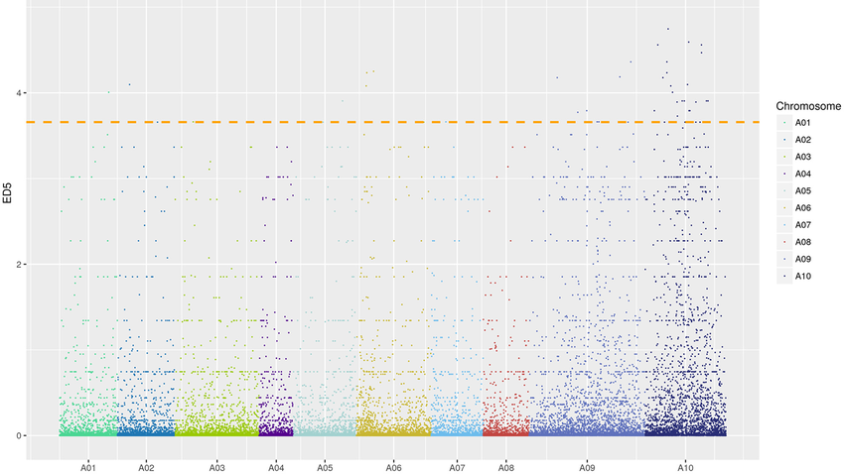
SNV Calling Pipeline with Snakemake (chr20)
Meryem Topcu
26 Nov 2026

Slide 2
Project goal
Build a SNV calling workflow using Snakemake.
Input: short-read sequencing data from the NA12878 sample and the human chromosome 20 reference (chr20.fa).
Output: VCF file containing the called variants for NA12878 on chr20.

Slide 3
Data set
Sample
NA12878: human genome sample.
Raw Data
Sequencing reads: Paired-end FASTQ
Files: SRR622461_1.fastq.gz SRR622461_2.fastq.gz
Source: NCBI SRA
Total size: ~7–8 GB (depending on compression)
Reference Genome
Chromosome: Homo sapiens chr20
File: chr20.fa
Source: Ensembl (GRCh38)
Why chr20?
Small size → fast workflow tests
Contains real polymorphisms → good for variant calling

Slide 4
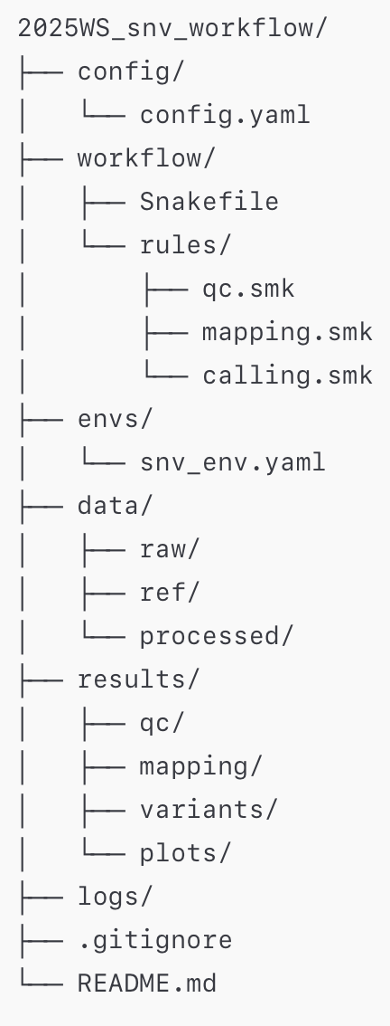
config.yaml → Stores sample IDs, file paths, and global parameters.
Snakefile → whole workflow;
qc.smk → the fastqc rule for raw read quality control.
mapping.smk →index_reference, bwa_map, sort_bam, index_bam.
calling.smk → call_variants and related steps for VCF generation.
snv_env.yaml→ Defines the conda environment so the workflow is reproducible.

Slide 5
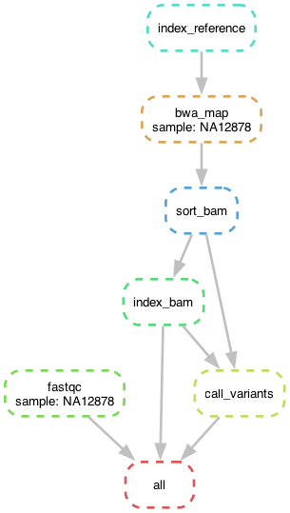
What the workflow does
Runs quality control on the raw FASTQ file using FastQC.
Aligns reads to the chr20 reference using BWA and generates a sorted, indexed BAM file.
Performs variant calling with bcftools (mpileup + call) and produces a compressed, indexed VCF file (NA12878.vcf.gz).

Slide 6
rule_ name | Input_files | Output_files | Description
fastqc | data/raw/{sample}.fastq.gz | results/qc/{sample}_fastqc.html; results/qc/{sample}_fastqc.zip | Run FastQC on raw FASTQ reads to generate a QC report.
index_reference | data/ref/chr20.fa | data/ref/chr20.fa.amb; data/ref/chr20.fa.ann; data/ref/chr20.fa.bwt; data/ref/chr20.fa.pac; data/ref/chr20.fa.sa | Build BWA index files for the reference chromosome.
bwa_map | data/raw/{sample}.fastq.gz; data/ref/chr20.fa; BWA index files | results/mapping/{sample}.bam | Align raw reads to the reference chromosome with BWA and convert to BAM.
sort_bam | results/mapping/{sample}.bam | results/mapping/{sample}.sorted.bam | Sort BAM alignments by genomic coordinates.
index_bam | results/mapping/{sample}.sorted.bam | results/mapping/{sample}.sorted.bam.bai | Create BAM index (.bai) for the sorted BAM file.
call_variants | results/mapping/{sample}.sorted.bam; results/mapping/{sample}.sorted.bam.bai; data/ref/chr20.fa | results/variants/{sample}.bcf; results/variants/{sample}.vcf.gz | Call variants using bcftools mpileup + call and produce BCF + VCF outputs.
all | (implicit: all final targets) | results/qc/{sample}_fastqc.html; results/mapping/{sample}.sorted.bam.bai; results/variants/{sample}.vcf.gz | Snakemake final target: pipeline is complete when QC, mapping and variant files are present.

Slide 7
Workflow Rule Summary
Rule Name | Input Files | Output Files | Short Description
fastqc | data/raw/{sample}.fastq.gz | results/qc/{sample}_fastqc.html results/qc/{sample}_fastqc.zip | Runs quality control on raw reads using FastQC.
index_reference | data/ref/chr20.fa | chr20.fa.amb, .ann, .bwt, .pac, .sa | Builds BWA index files for the chromosome 20 reference FASTA.
bwa_map | FASTQ + chr20.fa + BWA index | results/mapping/{sample}.bam | Aligns sequencing reads to chr20 using BWA and produces unsorted BAM.
sort_bam | {sample}.bam | {sample}.sorted.bam | Sorts BAM by genomic coordinates (required for variant calling).
index_bam | {sample}.sorted.bam | {sample}.sorted.bam.bai | Creates BAM index for efficient random access.
call_variants | Sorted BAM + BAM index + chr20.fa | {sample}.bcf, {sample}.vcf.gz | Calls variants using bcftools mpileup + call. Produces final VCF.
all | (final targets) | FastQC HTML, sorted BAM index, VCF.gz | Snakemake final rule: workflow ends when all targets exist.
Notes:
“From raw sequencing reads to a variant-containing VCF: each step transforms the data into a more structured, interpretable form.”
Proje çıktıları:
QC
results/qc/NA12878_fastqc.html
results/qc/NA12878_fastqc.zip
Mapping
results/mapping/NA12878.sorted.bam
results/mapping/NA12878.sorted.bam.bai
Variant calling
results/variants/NA12878.bcf
results/variants/NA12878.vcf.gz
results/variants/NA12878.vcf.gz.csi

Slide 8
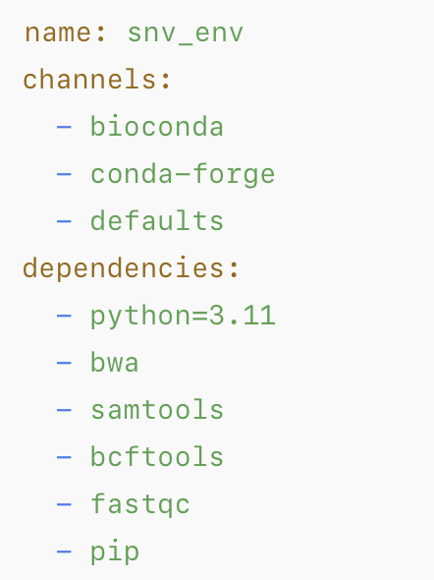
envs/snv_env.yaml
Notes:
“All required tools (BWA, samtools, bcftools, FastQC) are pinned in a conda environment (snv_env.yaml) so the workflow is reproducible on any machine.”

Slide 9
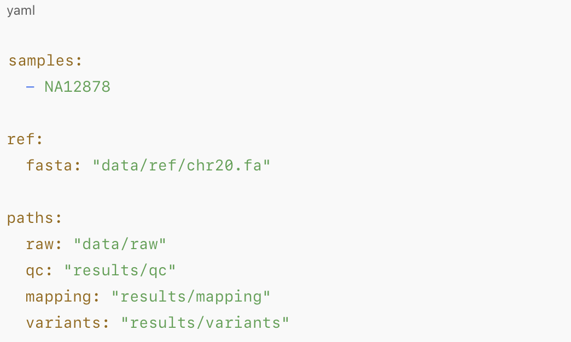
config/config.yaml
Central configuration: sample list, reference genome, and main paths.

Slide 10
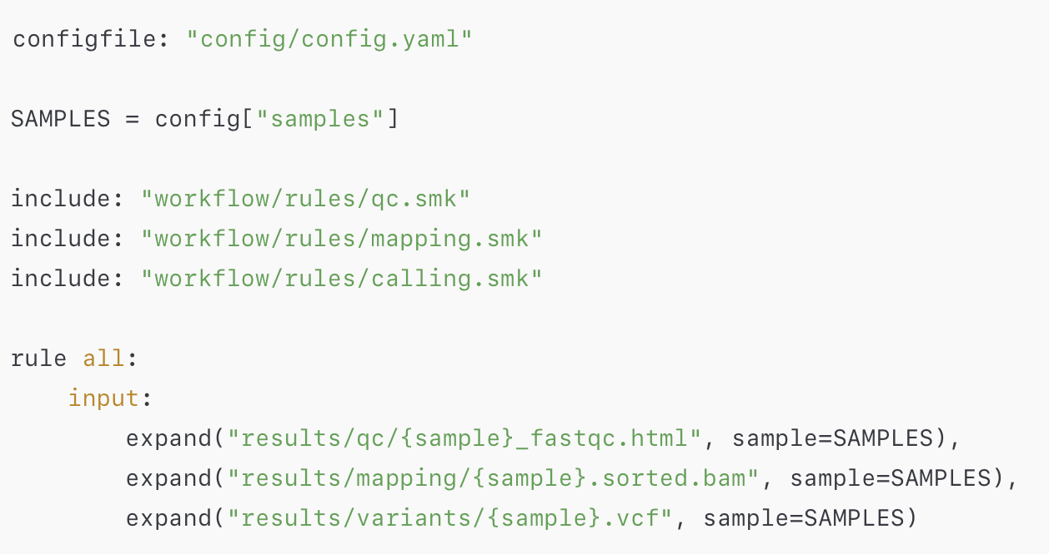
workflow/Snakefile
Notes:
Snakefile includes modular rule files and defines the final targets with rule all.

Slide 11
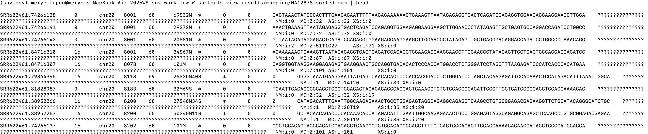
BAM file
Notes:
samtools quickcheck results/mapping/NA12878.bam && echo "BAM OK” → if my BAM file is done content of BAM file samtools view results/mapping/NA12878.sorted.bam | head ls -lh results/mapping/NA12878.sorted.bam.bai
-rw-r--r-- 1 meryemtopcu staff 169K Nov 26 14:28 results/mapping/NA12878.sorted.bam.bai

Slide 12
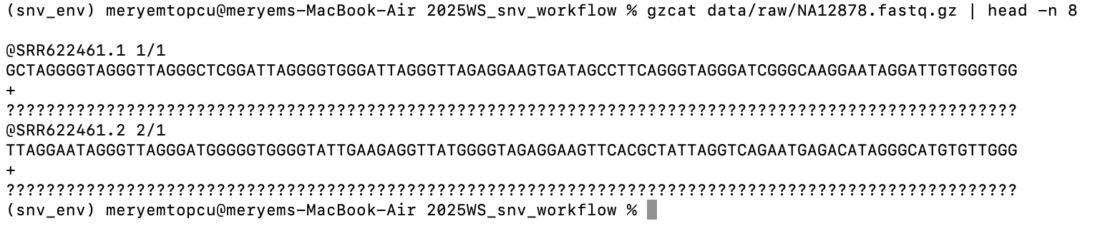
FASTQ

Slide 13
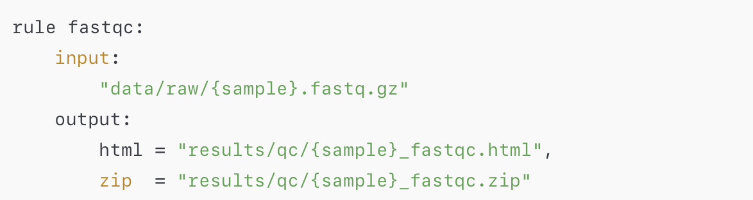
workflow/rules/qc.smk – FastQC
Notes:
Quality control of raw reads with FastQC (per sample).

Slide 14
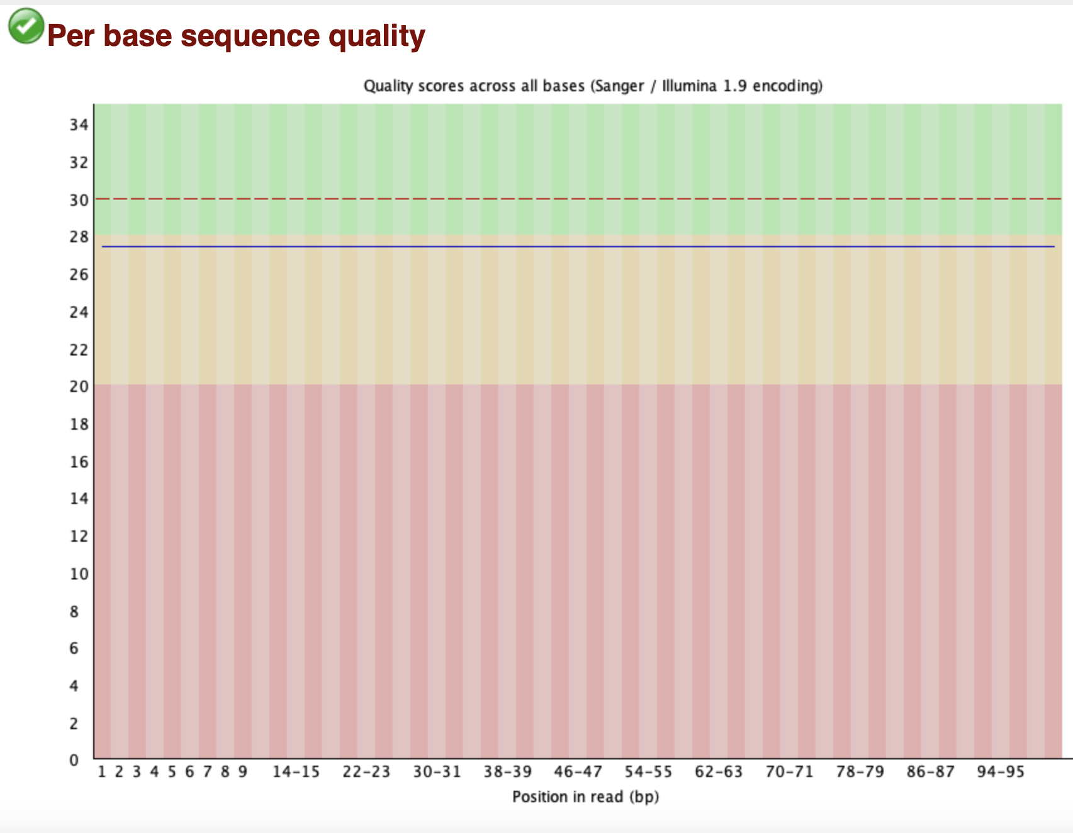
NA12878_fastqc Report
FastQC – Raw Data Quality Assessment
Input: NA12878 FASTQ
Purpose: Evaluate raw read quality before alignment
Result: All major modules show PASS → data is high quality
Next Step: Proceed to BWA alignment
Notes:
FastQC – Raw Data Quality Assessment
Input: NA12878 FASTQ
Purpose: Evaluate raw read quality before alignment
Result: All major modules show PASS → data is high quality
Note: Slight GC deviation is observed but typical for Illumina data and not problematic
Next Step: Proceed to BWA alignment

Slide 15
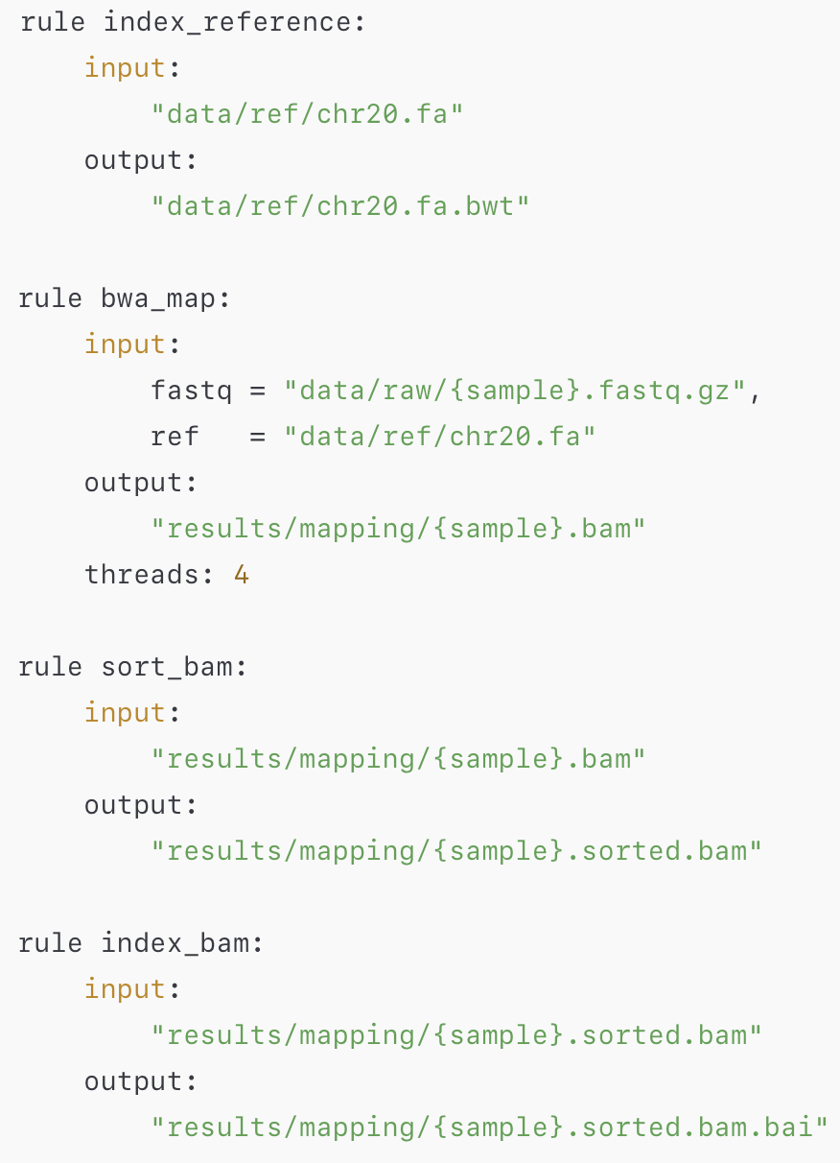
workflow/rules/mapping.smk
Mapping converts raw sequencing reads into an analysis-ready, sorted, and indexed BAM file.
Index_reference
Prepare the reference genome so BWA can use it for alignment.
bwa_map
Align raw FASTQ reads to chr20 and produce an aligned BAM file.
sort_bam
Reorder the BAM by genomic coordinates so downstream tools can read it properly.
index_bam
Create an index for fast, random access to any genomic position.
Notes:
Mapping = FASTQ → BAM
“Reads are aligned to the reference genome and prepared for analysis.”
index_reference: prepare chr20 reference for BWA
bwa_map: align reads to chr20 → BAM
sort_bam: sort BAM by genomic coordinate
index_bam: create BAM index for fast access

Slide 16
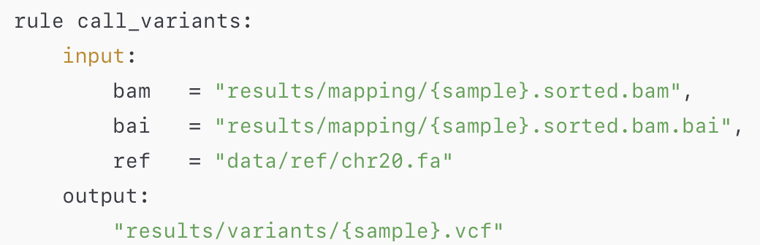
workflow/rules/calling.smk
Calling identifies true differences between the sample and the reference genome and writes them into a VCF.
call
Detect positions that differ from the reference and output them as SNPs/indels in a VCF file.
Notes:
Calling = BAM → VCF
“Differences from the reference are detected and written as variants.”
“Creates a quick-lookup index so tools can jump directly to any position in the genome.”

Slide 17
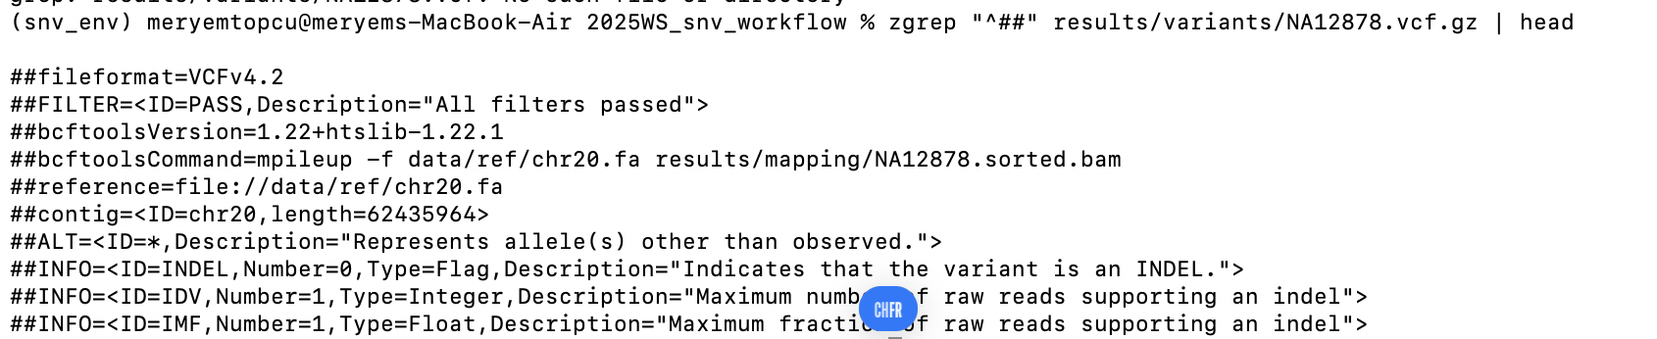
VCF
Notes:
ls -lh results/variants
total 40512
-rw-r--r-- 1 meryemtopcu staff 9.9M Nov 26 14:35 NA12878.bcf
-rw-r--r-- 1 meryemtopcu staff 9.7M Nov 26 14:35 NA12878.vcf.gz
-rw-r--r-- 1 meryemtopcu staff 28K Nov 26 14:35 NA12878.vcf.gz.csi

Slide 18
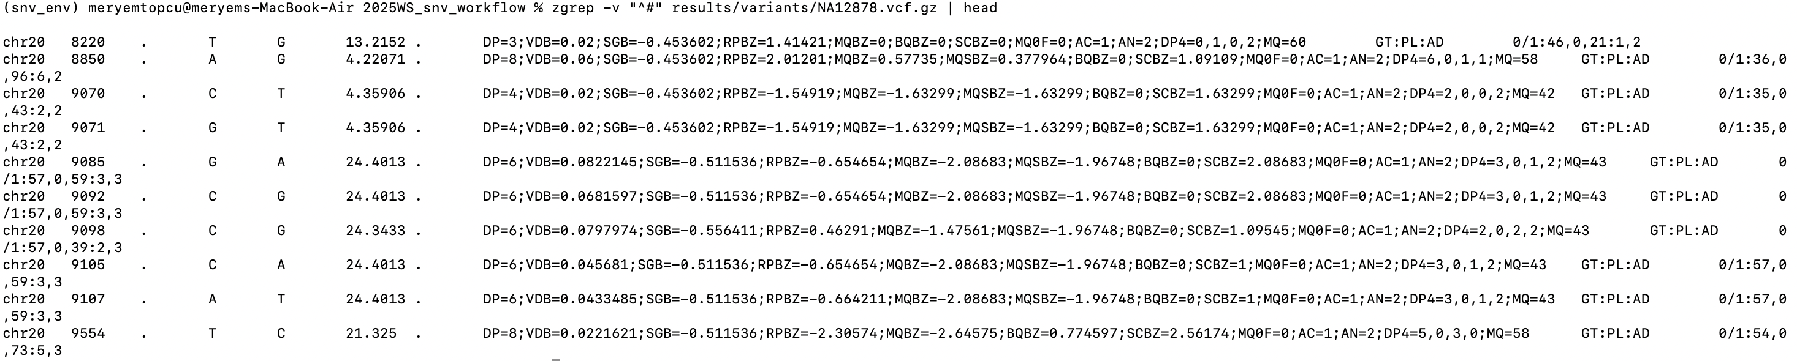
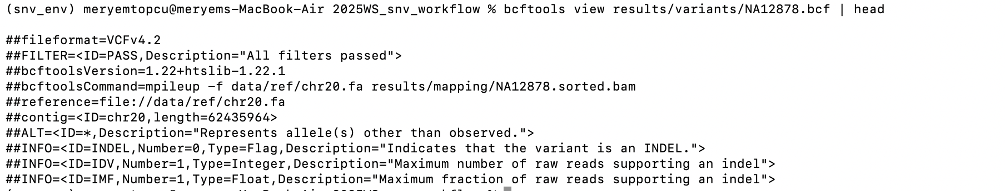
VCF Variant Lines & Number
Notes:
“Our pipeline successfully detected ~248k SNVs/indels on chr20. Each line contains position, reference base, sample base, depth, genotype, and quality metrics.”

Slide 19
Read Alignment with BWA-MEM
Raw FASTQ reads are aligned to the reference genome (chr20).
BWA-MEM finds the best-matching positions of each read along the reference.
Output is an unsorted BAM file containing mapped reads.
This step converts “raw sequences” into “genome-positioned data,” enabling downstream variant calling.

Slide 20
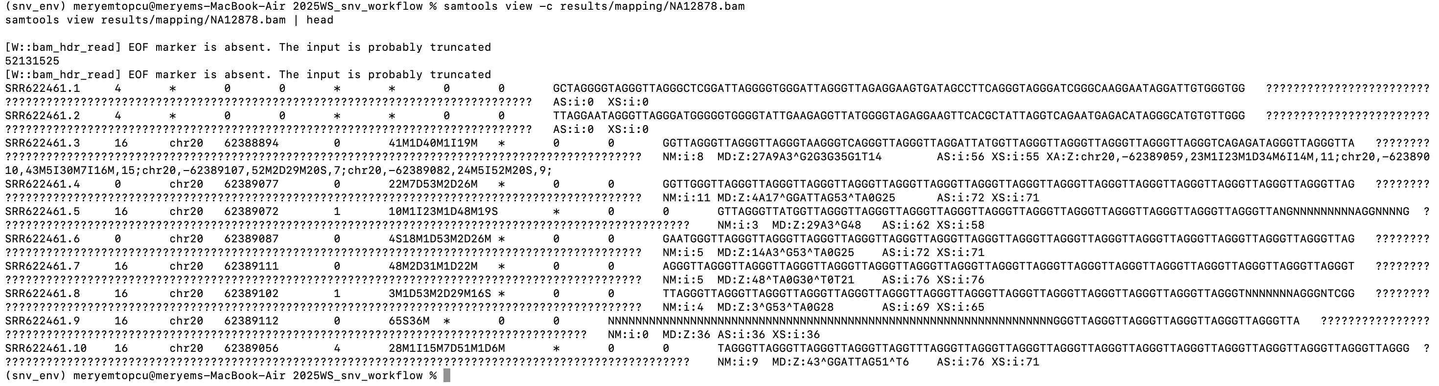
BAM

Slide 21
Main result
A fully reproducible Snakemake workflow that goes from raw FASTQ and a reference genome to final variant calls for NA12878 on chromosome 20.

Slide 22
Result:
End-to-end SNV calling workflow for the NA12878 sample on human chromosome 20. The pipeline runs FastQC, BWA, samtools and bcftools under Snakemake and produces a final VCF file (results/variants/NA12878.vcf.gz) with the called variants.

Slide 23
Results: Variant Calling Summary (chr20)
Input:
Sample: NA12878
FASTQ size: X GB
Reference: GRCh38 chr20
Pipeline steps:
FastQC
Alignment (BWA-MEM)
Sorting
Indexing
Variant calling (bcftools)

